Slide 1
What in the world are we doing?
We are glad you asked…

Slide 2
The Evangelical Covenant Church of Canada is working in…
Palestine
Haiti
Congo
Ecuador

Slide 3
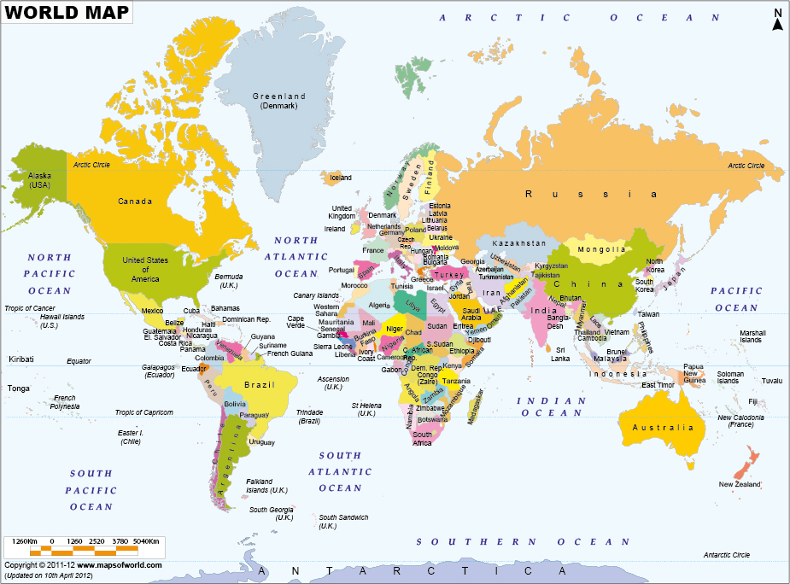

Slide 4
HAITI:
Eben-Ezer Clinic has treated 4,000 cholera patients.
Daily clinic care happens for about 120 people.
The food program provides food for older Haitians through the women’s ministry of the local church.
Electricity to power the clinic comes from a donated generator and solar panels.
The facility has been expanded to accommodate overnight patients.
Janelle Peterson has been serving as an ECCC missionary for two years.

Slide 5
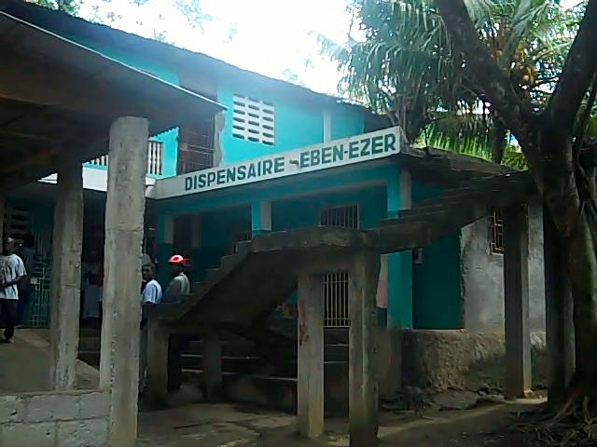

Slide 6
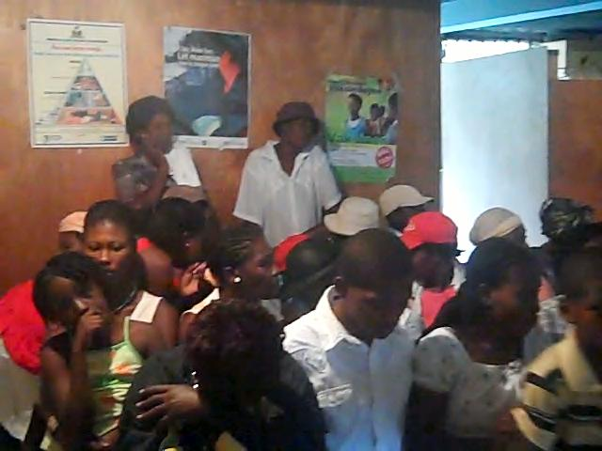
Clinic waiting room.

Slide 7
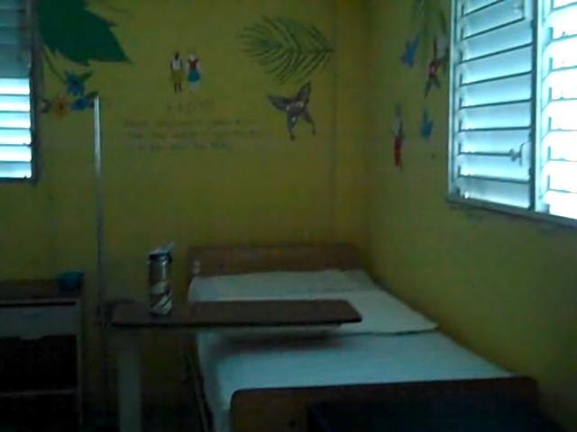
Pediatric room, decorated by Lighthouse Church in Sarnia.

Slide 8
Clinic Generator

Slide 9
The ECCC is committed to sponsoring 100 children in the area of Jenin through World Vision.
Women Ministries and the ECCC have partnered with Dina Katanacho at Galilee Bible College in Nazareth to help educate Arab Christians.
Every other year the ECCC takes a group to Israel/ Palestine to learn about the ongoing struggle for reconciliation.
Mediterranean Sea
Jenin

Slide 10
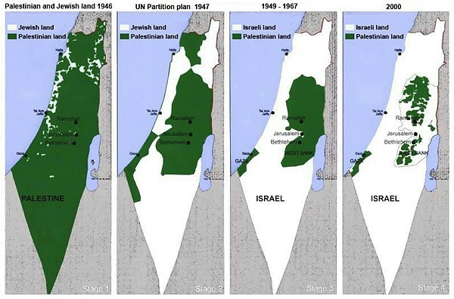

Slide 11
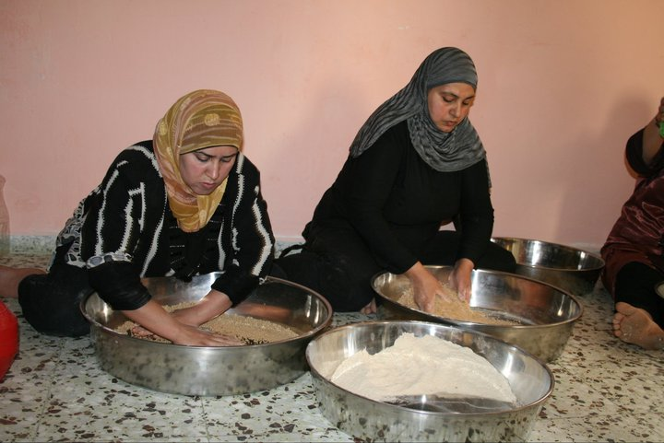
Women making couscous, a mirco- enterprise.

Slide 12
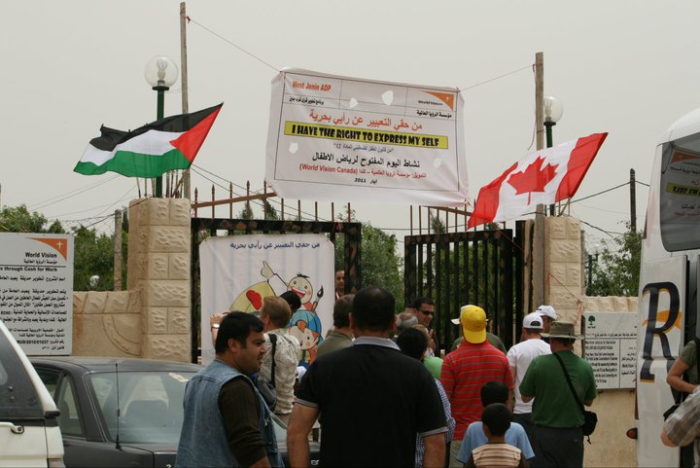

Slide 13
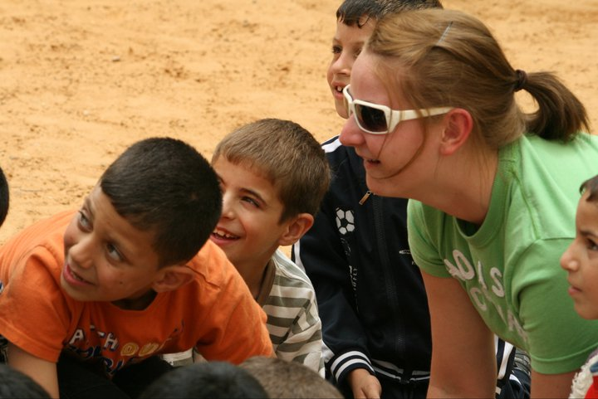

Slide 14
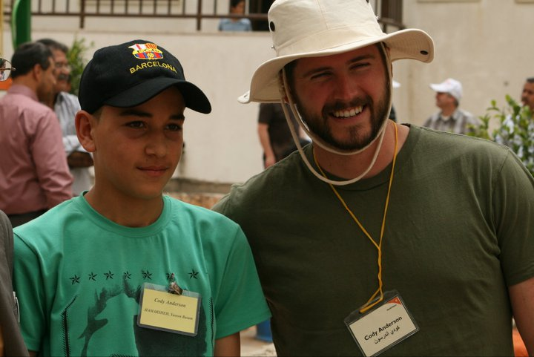

Slide 15
ECUADOR:
85 Covenant Churches
The country is1/3 size of Alberta with huge range of ecology from 15,000 ft mountains to sea side fishing villages.
Oil and bananas are the biggest exports.
Sumaco is a small village in an ecological reserve of 250 people.
Whole village moved there after devastating mudslide and earthquake killed many in the old location.
Jenel and Andy Pluim plus several other ECCCers went to serve the area earlier this year…

Slide 16
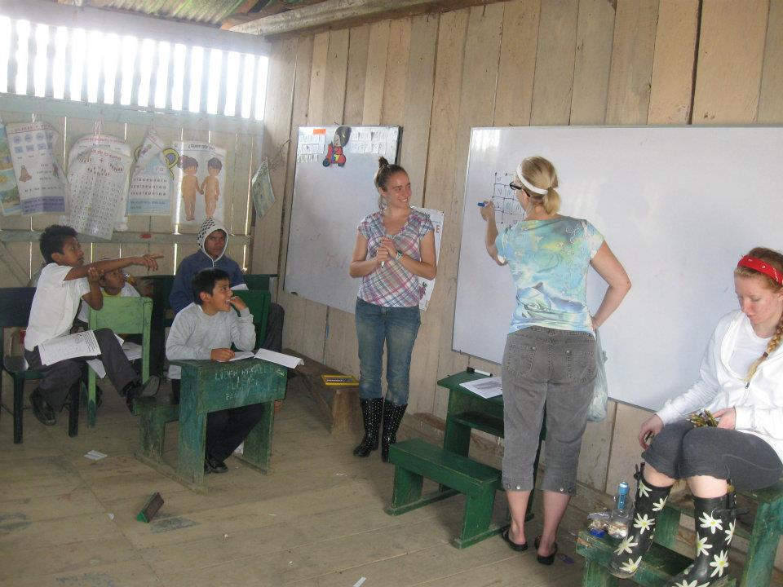
Health Classes

Slide 17
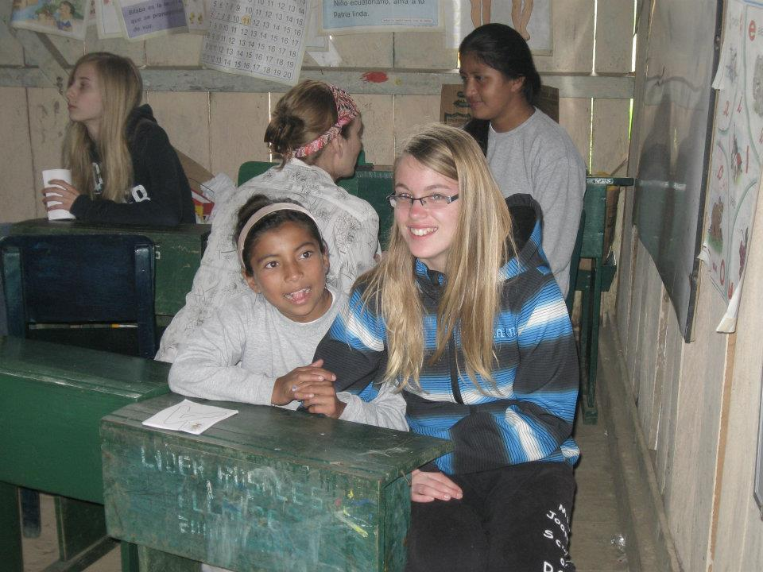
Teaching English

Slide 18
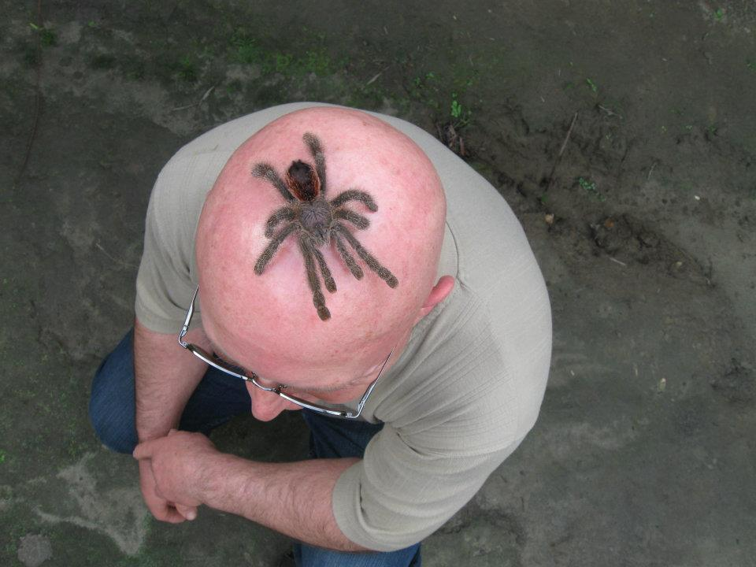
Fun with the natives…

Slide 19
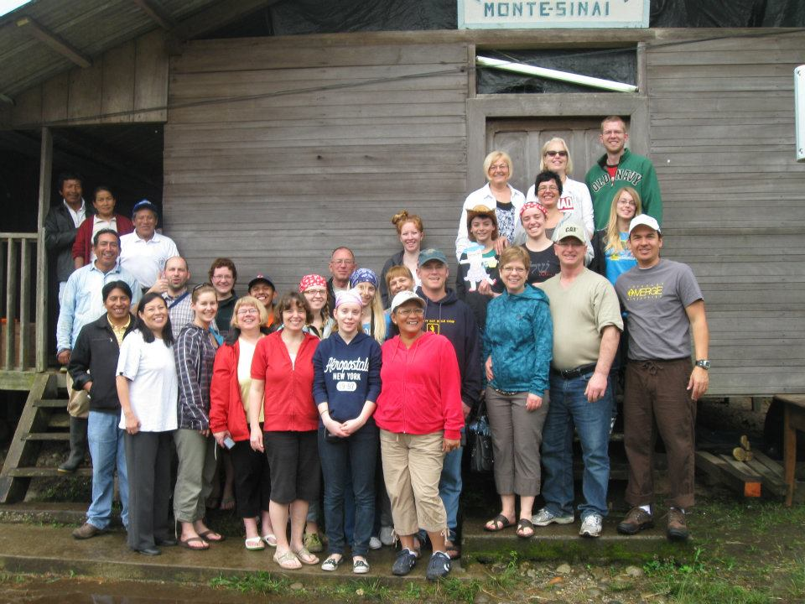
The team!

Slide 20
CONGO:
This year marks the 75th anniversary of the Covenant Church in Congo.
The Democratic Republic of Congo covers 2,344,858 square kilometers of land in the centre of Africa, making it the 12th largest country in the world. Population is 67.7 million.
Gross National Income is $180.00 US per year. - this makes it the poorest or perhaps the next to poorest country in the world.
Infant mortality (infants under 1 year) is 115.81 deaths per1000 live births for the years 2005 to 2010.
In Canada about half the population is under 40 years of age. In the Congo, half the population is under 16.5 years.
In Canada 99% of the population is literate. That number is 66.6% for the Congo.
"A group of peaceful demonstrators with Bible in hand is more powerful in the Congolese context than mobs throwing stones." BBC News

Slide 21
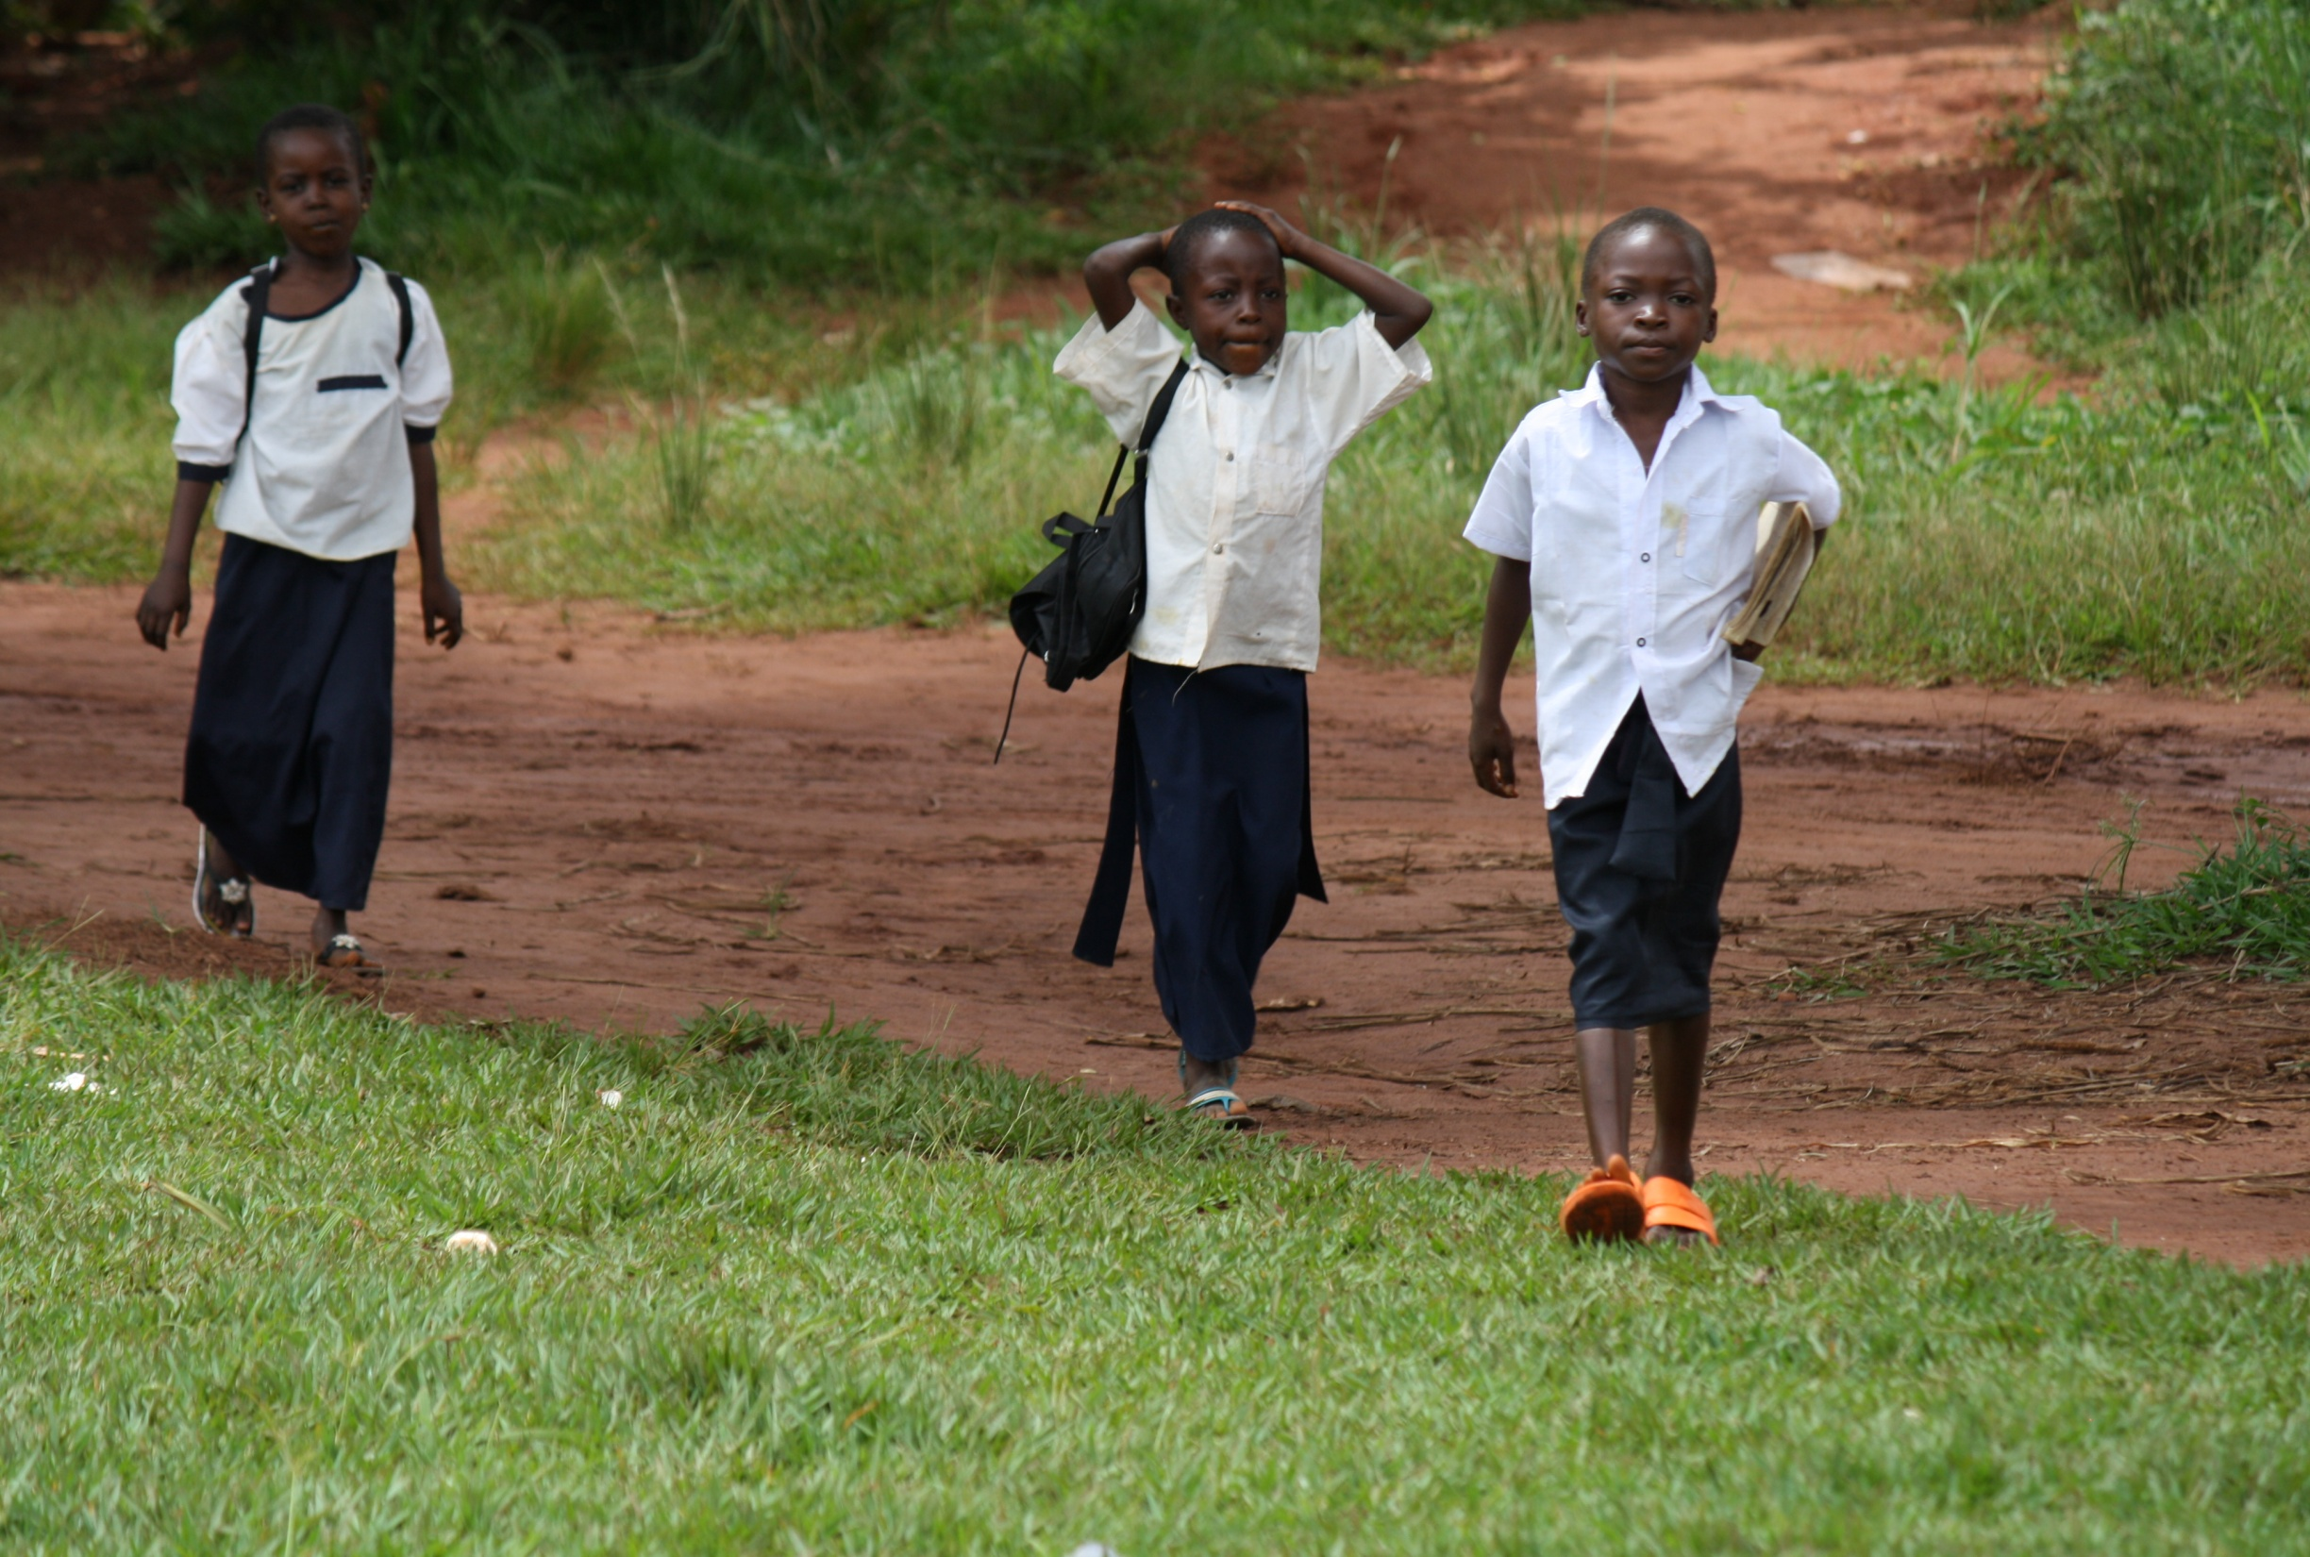
The ECCC is committed to providing 200 child sponsorships through World Vision.

Slide 22
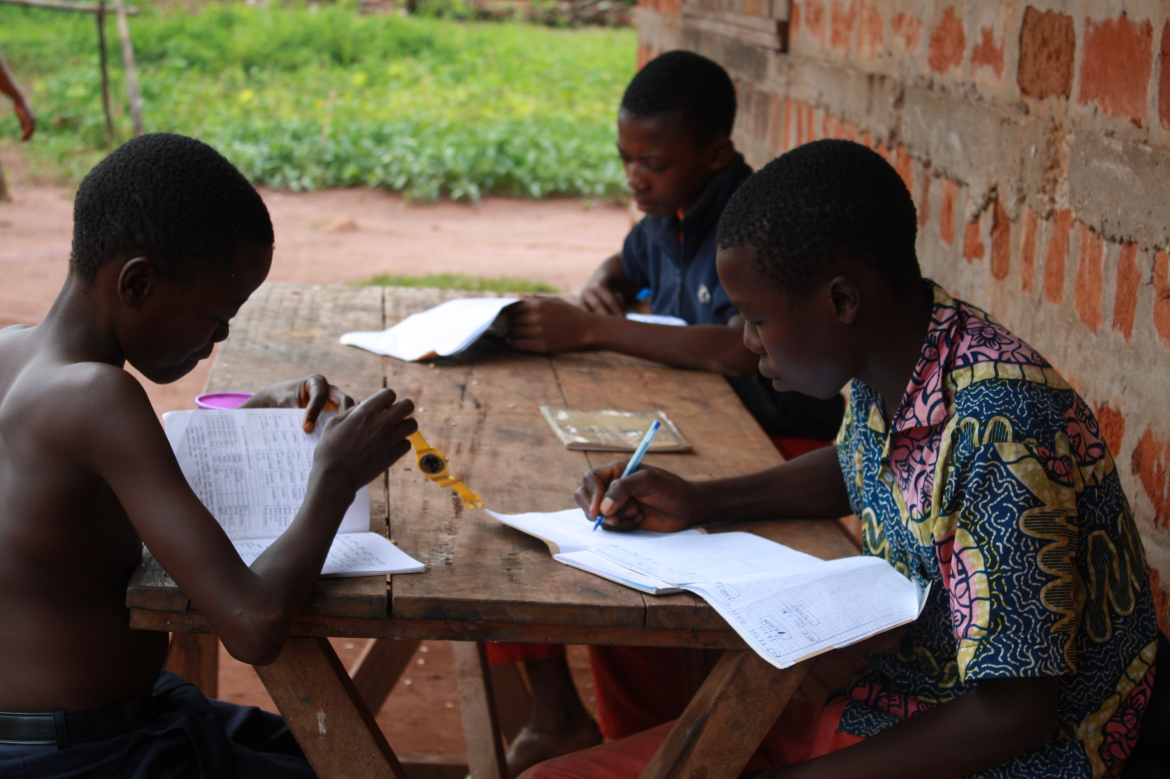
The ECC is working towards 10,000 sponsorships.

Slide 23
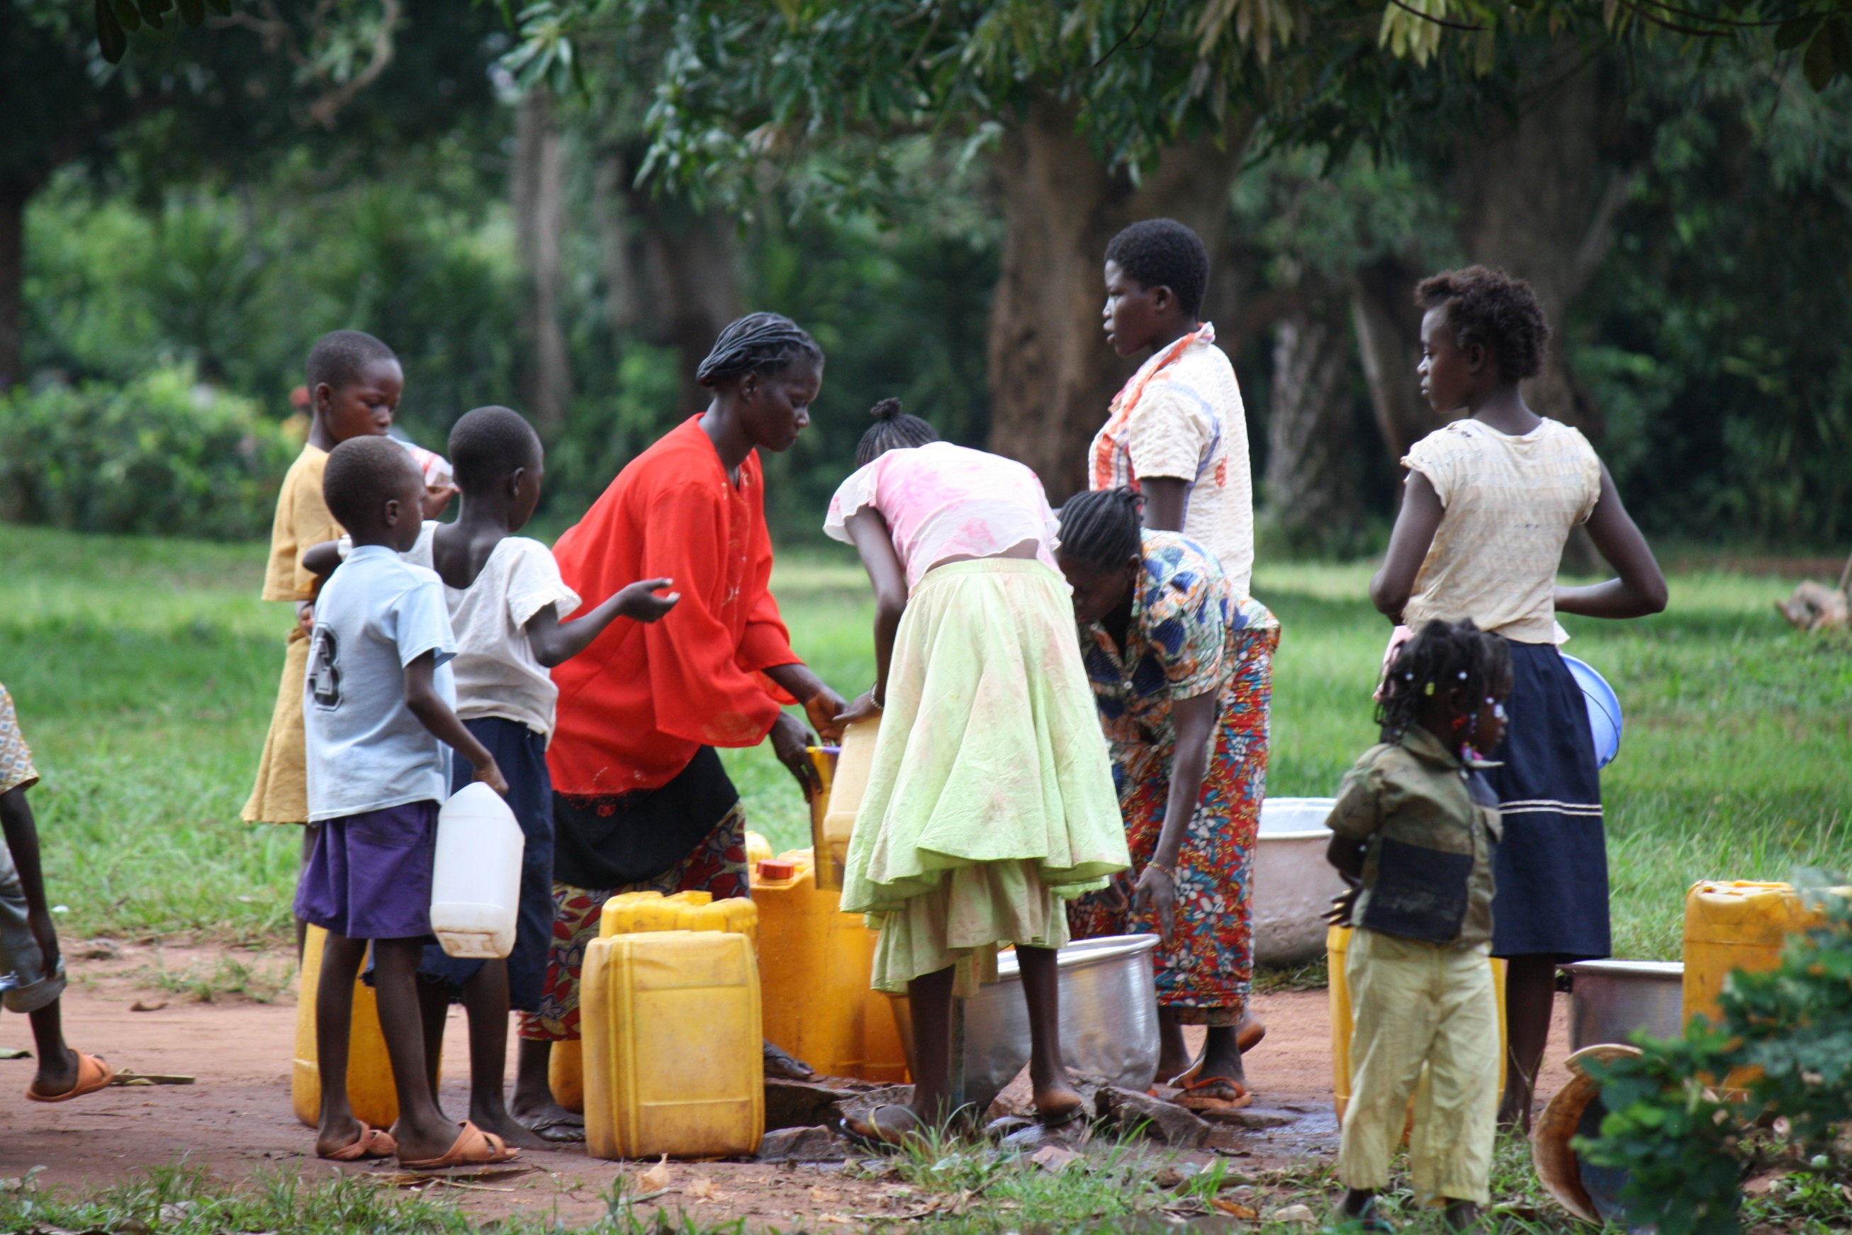
Sponsorships help provide clean water…

Slide 24
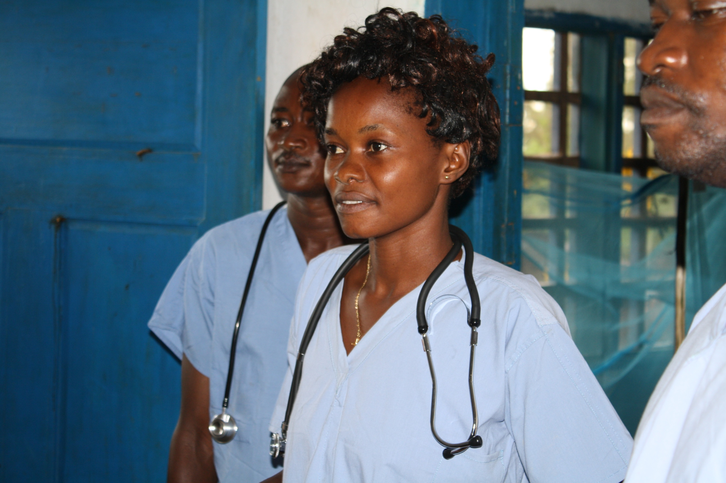
Health care…

Slide 25
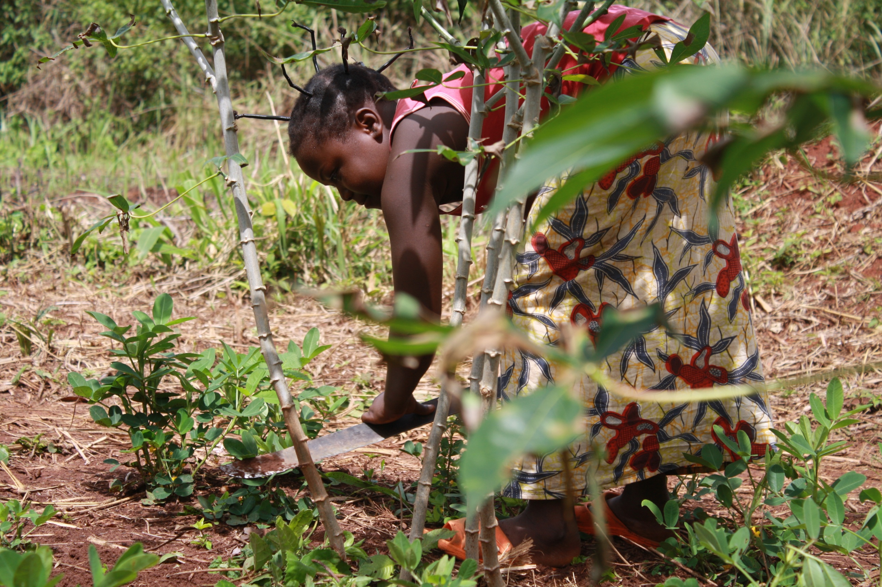
And more.

Slide 26
Kernels of Hope has chosen to continue the work in North Kivu, Congo for the next three years. The growing project in North Kivu for 2011 exceeded expectations for support. So we are able to move forward on a new project earlier than expected.
This new project will support seed distribution to farmers, farming tool kits, training in farming and more.
$200 buys an acre of virtual farm land! – And the federal government matches every dollar with $4! That’s good math.
See the hand out from World Relief Canada, Kernels of Hope, and the ECCC for more information.

Slide 27
There are many ways to partner with us…
Please use the response cards to tell us how you want to get involved.

